Slide 1
Arduino Workshop
School of Computing Science and Digital Media
Applicant’s Day

Slide 2
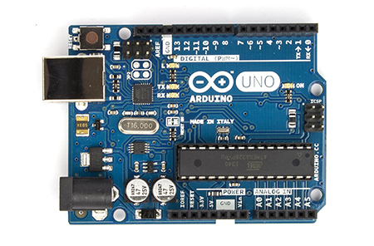
Today - Arduinos!
An Arduino board is a microcontroller.
Several different kinds – all are open source (can be freely cloned and adapted)
The one we are using today is an Arduino Uno.
Arduino has its own software to write code, and the language used to program it is a modified version of C/C++

Slide 3
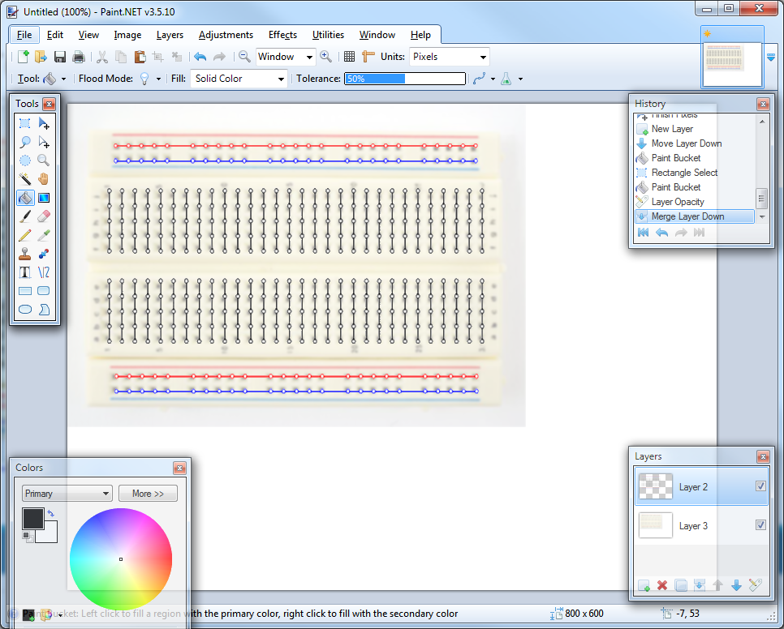
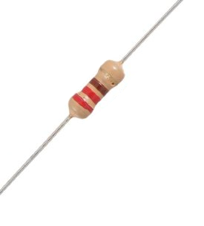
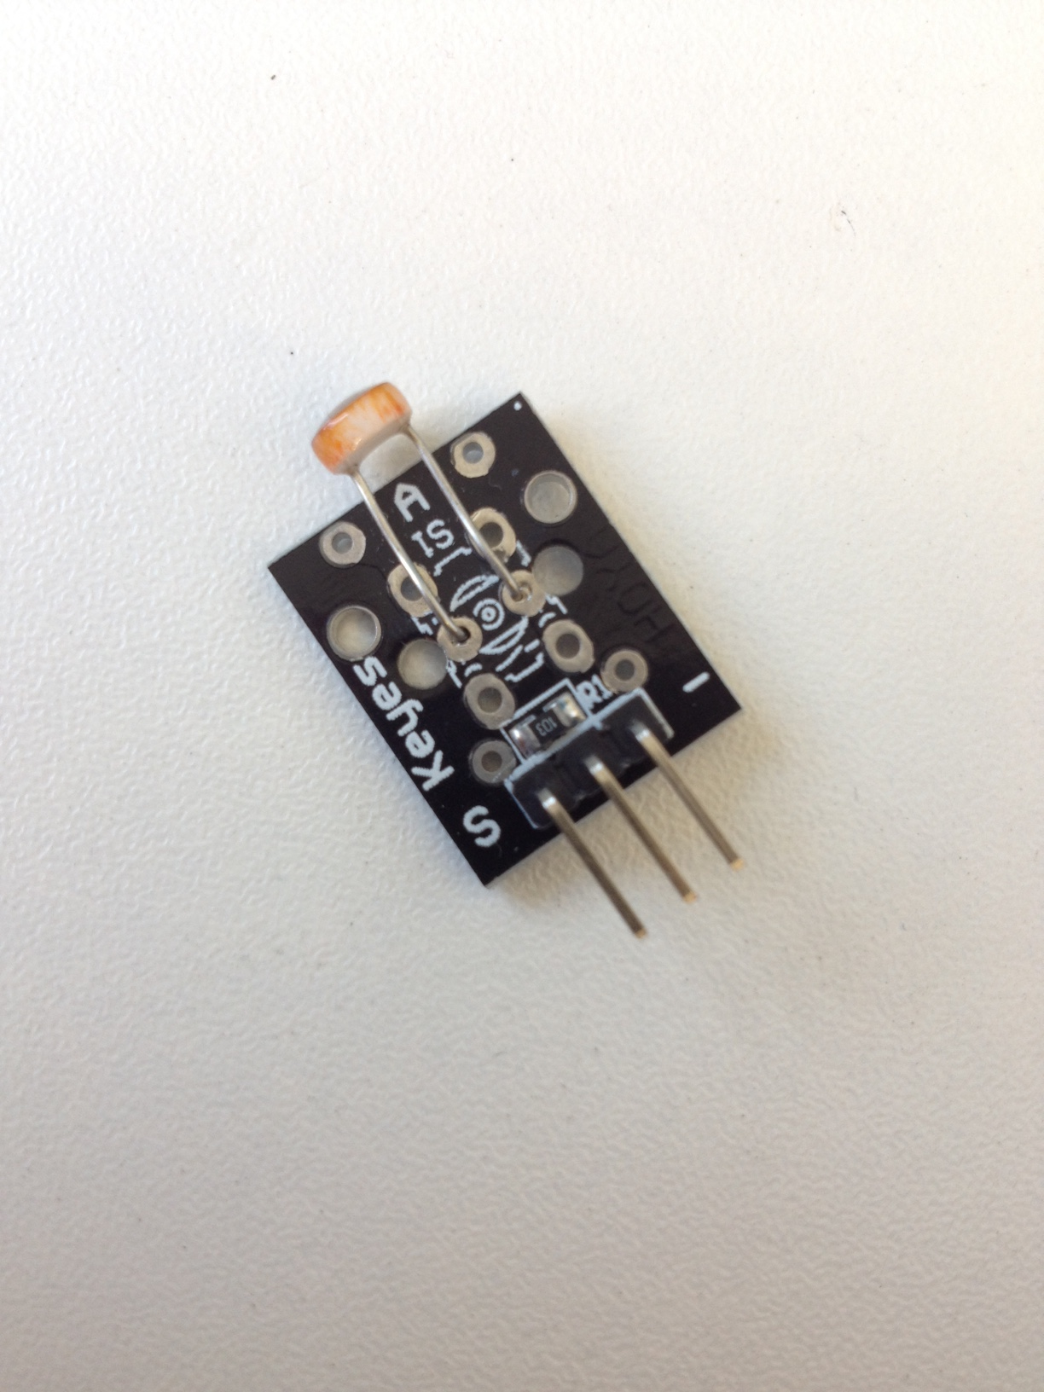
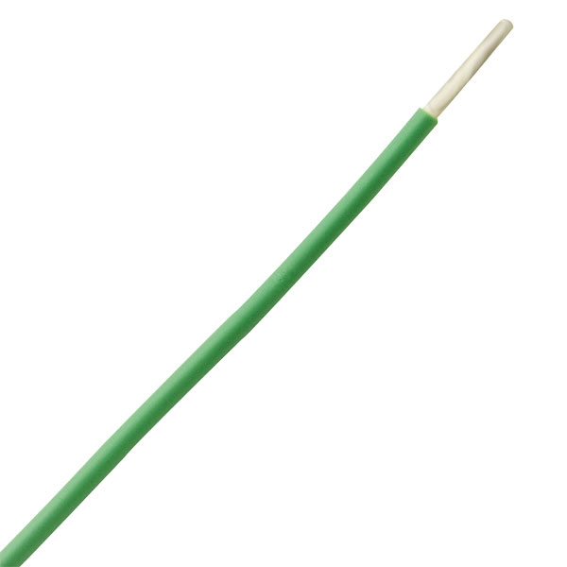
In Front Of You
Arduino
Breadboard
4 x Wires
Resistor
LED
Light Sensor

Slide 4
In Front Of You
The Arduino software with some base code provided
All input/output components will be connected to the Arduino using wires from the breadboard to a pin on the Arduino.
Which pin is the LED connected to?

Slide 5

Lets try running the code!
To upload your code to the Arduino and test it click the arrow button in the top left
Can you see the temperature values being printed out on the left of your screen?
What happens if you put your fingers around the heat sensor?

Slide 6
Brief Explanation of Code
Setup is where the code to say whether a pin is connected to an input or an output is put.
Some components must use specific pins, so pay attention to the connection instructions.
Notes:
Get them all to run the code and hold the sensor to see the light go on/off

Slide 7
Brief Explanation of Code
The loop is where the rest of the code goes.
An example if statement has been provided as well as code to read values from a sensor and to turn on/off an LED
Notes:
Get them all to run the code and hold the sensor to see the light go on/off

Slide 8
Todays Challenge – Smart Homes
Using your choice of one of our energy sensors – heat or light, as well as any of the additional components available, create something interesting.
Some suggested ideas:
Heat Sensor + LED’s to create a thermometer
Heat Sensor or Light Sensor + Buzzer to create an alarm system
But anything you want to do is fine!

Slide 9
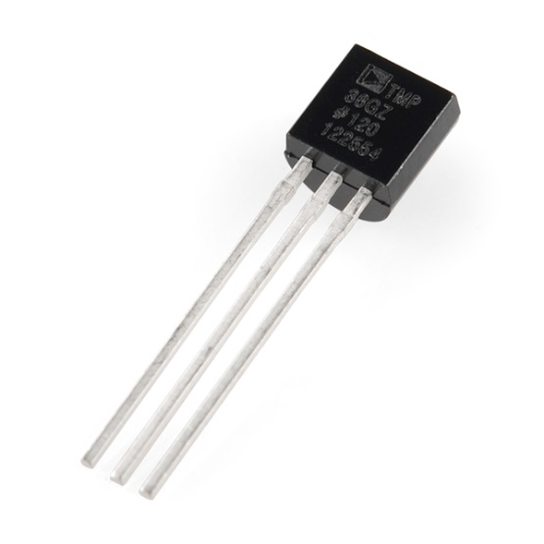
Connection Instructions for Components
Light Sensor (bumpy side) connects to:
- Pin (A0-A3)
- Ground
- Power
Value Range: 200 – 1200 (Dark – Light)
Heat Sensor (flat side) connects to:
- Power
- Pin (A0-A3)
- Ground
Notes:
This will be printed off for them to have

Slide 10
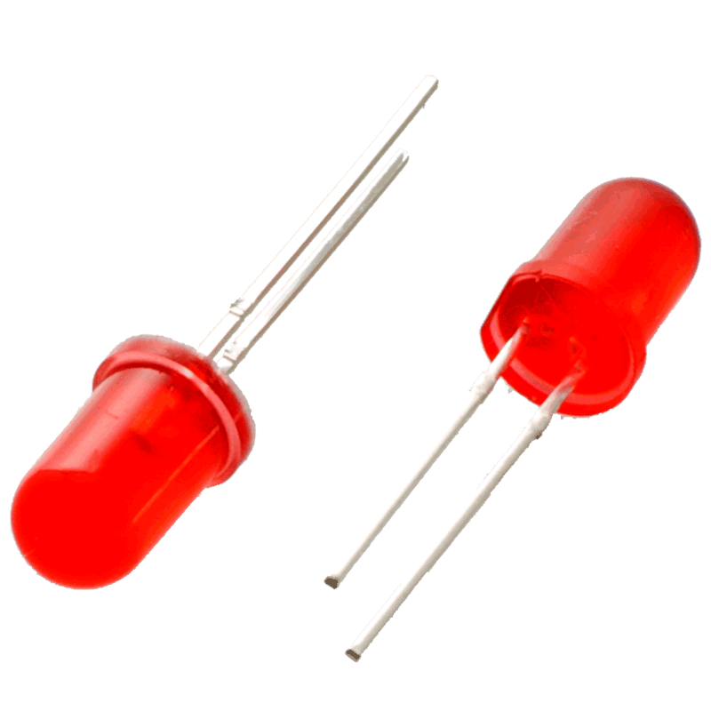
Connection Instructions for Components
Buzzer connects to:
- Pin 2-13 to + side
- Ground to other side
Code:
tone(pinNumber, frequency);
Frequency Range: 200 - 900
LED’s:
- Short leg into Ground
- Add a resistor to bridge the LED to the other side of the
board
- Connect wire from resistor to a pin (2-13)
Code:
digitalWrite(pinNumber, Value);
Value: HIGH for on, LOW for off
Notes:
This will be printed off for them to have

